Slide 1
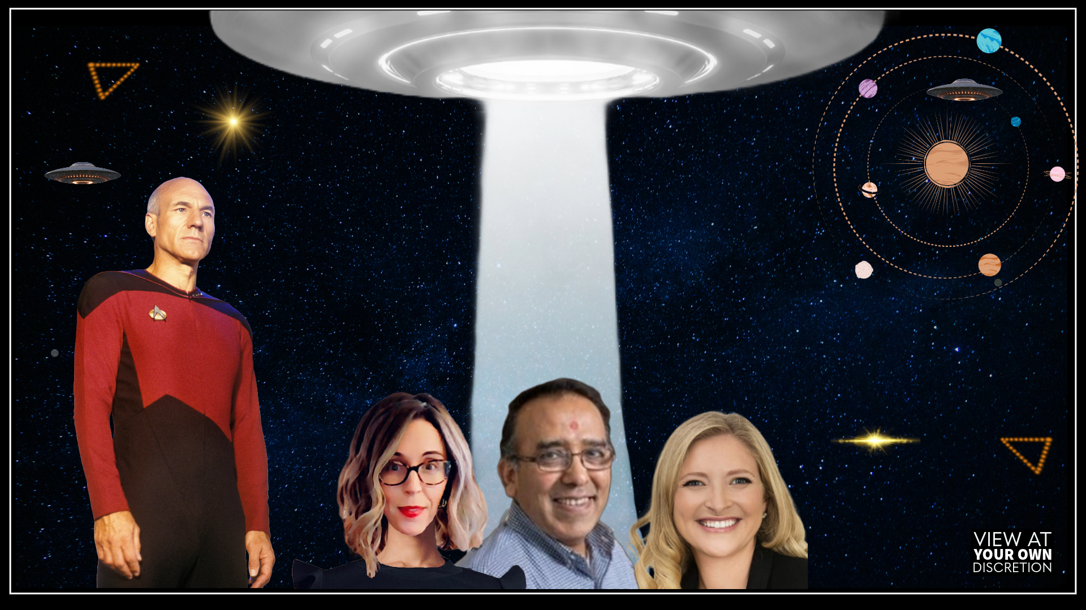

TEAM PICARD

Slide 2

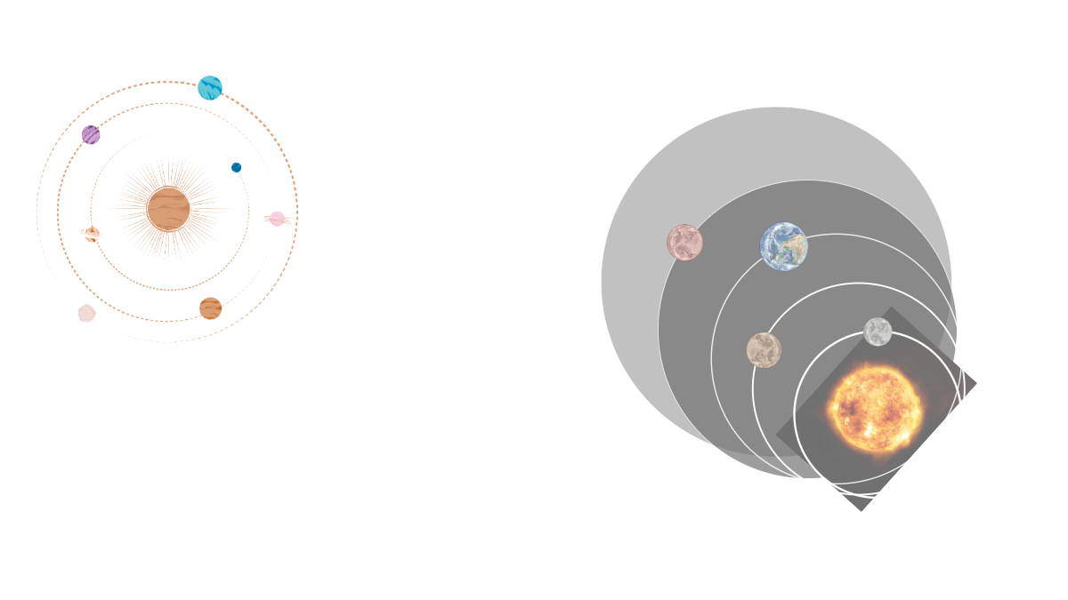
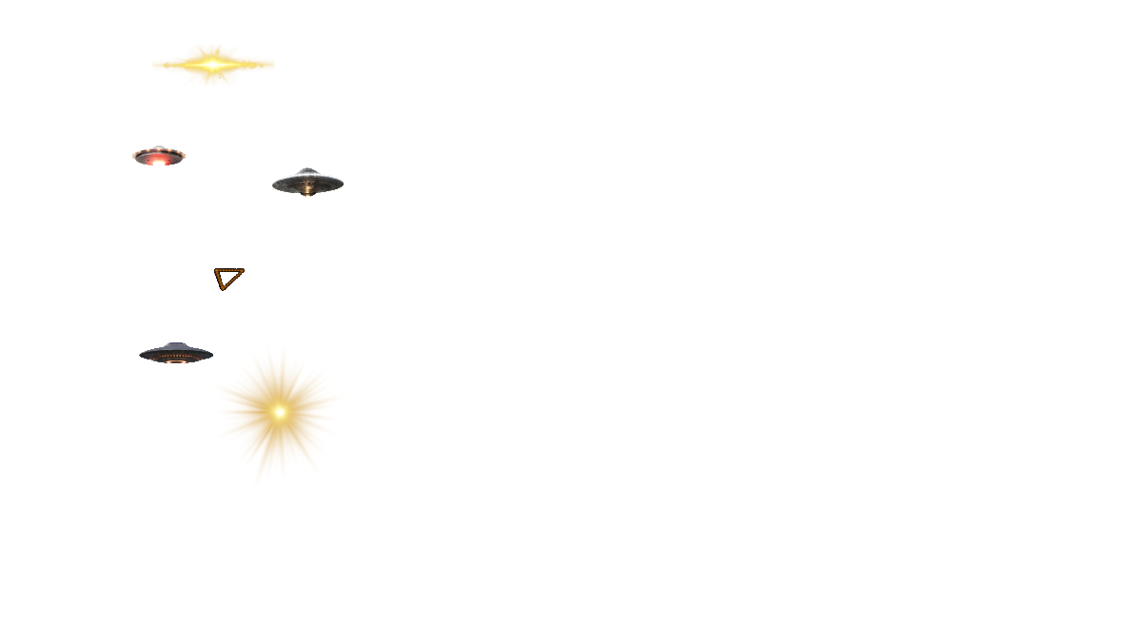
SOMETHING IS HAPPENING IN OUR SKIES
For decades there have been strange, unexplained sightings in the sky by the military, commercial airline pilots, and other trained observers all over the world
Many of these sightings have been confirmed by radar and FLIR (Forward Looking InfraRed) radar data
UFOs have been acknowledged by the U.S. Government in a recent report as a genuine mystery they have been studying for years
This topic should be taken seriously, without stigma, by our scientific communities and the general public so we can study and have a better understanding of the universe around us
Notes:
draft

Slide 3

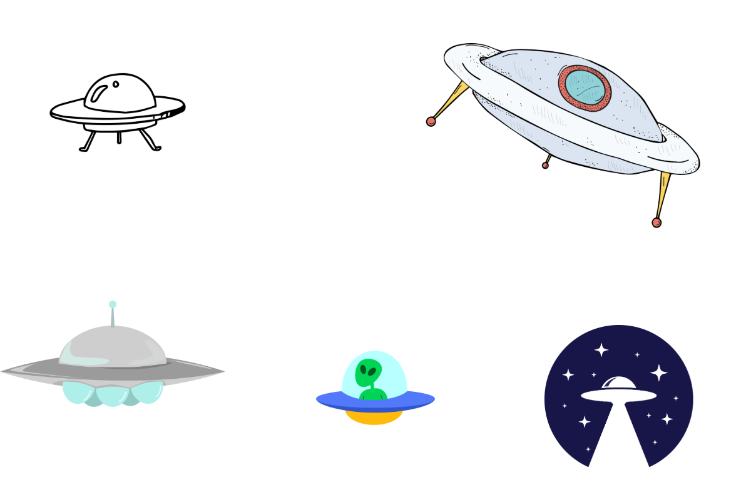
CREDIBLE GOVERNMENT OFFICIALS SPEAKING OUT
Harry Reid
Senate Majority Leader, NV
Paul Hellyer, Canada's
former minister of Defence
David Grush
Former intelligence official
Has been sounding the alarm on the need to find out what UFOs are since 2007.
Testified in D.C. in 2014 that “aliens are living among us” and “working with the U.S. government,” among other bombshells.
Testified the “U.S. government has evidence of "non-human" biologics.”
Haim Eshed, former Israeli Defense General & Space Chief
Nick Pope, Former officer,
British Ministry of Defence
Luis Elizondo, former intelligence officer, US DoD
2020: Claimed there’s a “galactic federation,” and that aliens are on a mission to understand the “fabric of the universe.”
Resigned as head of the Pentagon’s UFO Program because “UFOs exist — but the government doesn’t want you to know it.”
Where his duties included investigating reports of UFO sightings. Sounding the alarm since he left in 2006.
Notes:
https://www.huffpost.com/archive/ca/entry/paul-hellyer-ex-defence-minister-believes-in-aliens-video_n_3390295

Slide 4
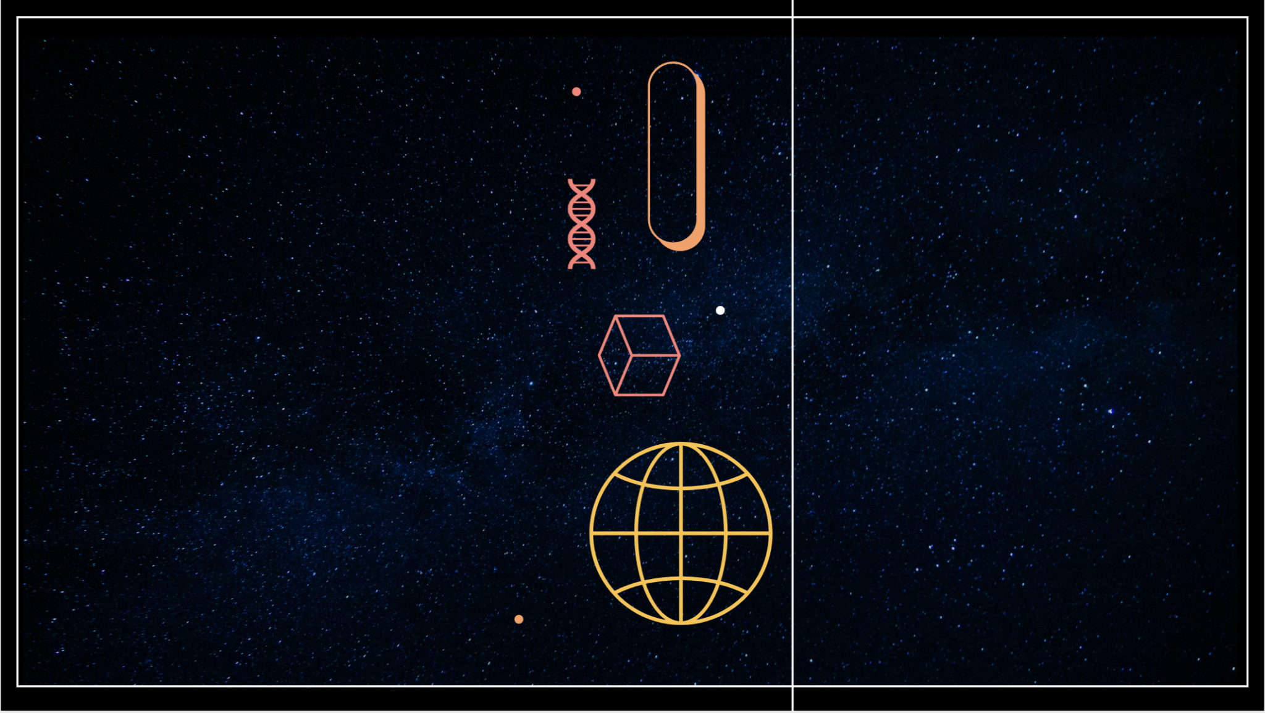
EXECUTIVE SUMMARY
QUESTIONS
What can we learn about previously documented and recorded UFO sightings?
What is the trend?
How do we utilize the trend to predict future sightings?
Are We Alone?
As far back as 1459 B.C., humans have documented unknown, technological objects in the sky
Congressional, Pentagon and various intelligence agencies reports concluded some are real, unknown objects
Sharing information on the basis of open data to answer a question that is clearly of great interest to the public, will enhance confidence in evidence-based knowledge
Provides the potential to learn so much, from technological advances to the meaning behind existence
NASA’s 2023 UAP Report noted that artificial intelligence and machine learning are essential for identifying rare occurrences, including UFOs
APPROACH
Divided and conquered based on everyone’s strengths
Understood the raw data
Identified key targets and sliced data as necessary
Stayed open-minded and willing to go where no (hu)man has gone before
Notes:
How did we pick UFOs?
An executive summary or overview of the project and project goals:
Explain how the project relates to the industry you selected.
Questions?
What can we learn about previously documented and recording sightings UFO sightings?
Can we use this historical data to predict trends in future UFO sightings?
Can we use historical data to predict future UFO sightings?
Our approach

Slide 5
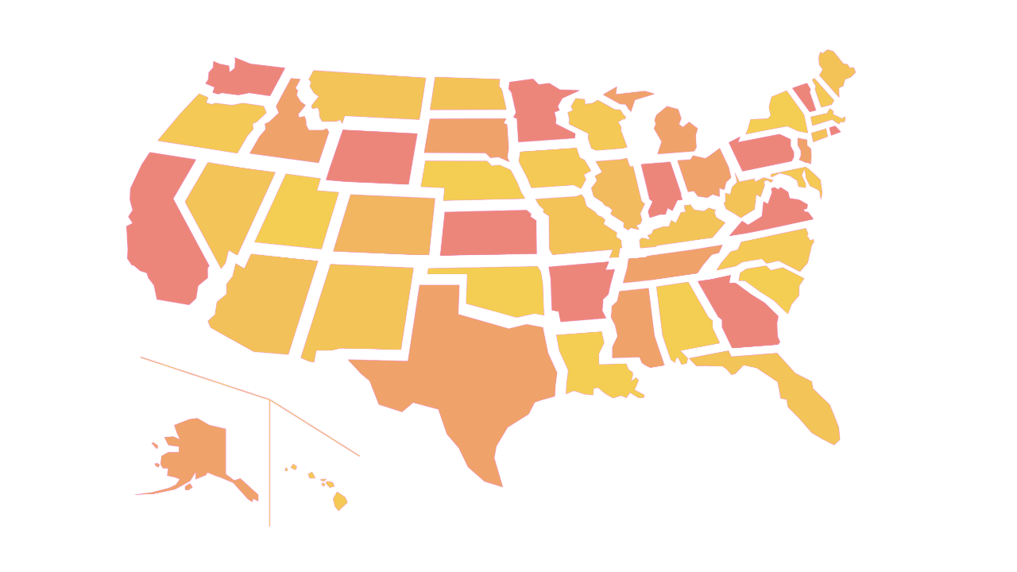
1997 Phoenix, AZ Lights
Hundreds of witnesses claimed to see "otherworldly" lights across AZ, NV and Mexico
CREDIBLE UFO SIGHTINGS
2001 New Jersey Turnpike
Drivers marveled at the sight of strange orange and yellow lights in a V formation over NY and NJ
2004 San Diego, CA USS Nimitz
Carrier strike group tracked objects at 80,000 ft high plummet to hover right above the Pacific
2006 Chicago, IL O'Hare Airport
UFO sighting witnessed by 12 United Airlines employees outside and above the airport
2008 Stephenville, TX Sightings
Reported white lights in a single horizontal arc, then in vertical parallel lines a mile long traveling 3,000 mph
2010 Washington, DC
Missile launch officers saw UFOs hovered over launch sites send beams of light into silos holding nuclear missiles, sometimes disabled or briefly activated them
2011 Lafayette, CO Sightings
Residents saw a strange triangular formation of lights hovering above Lafayette that looked like tiny, bright alien ships. No sound was reported

Slide 6

DATA

Slide 7
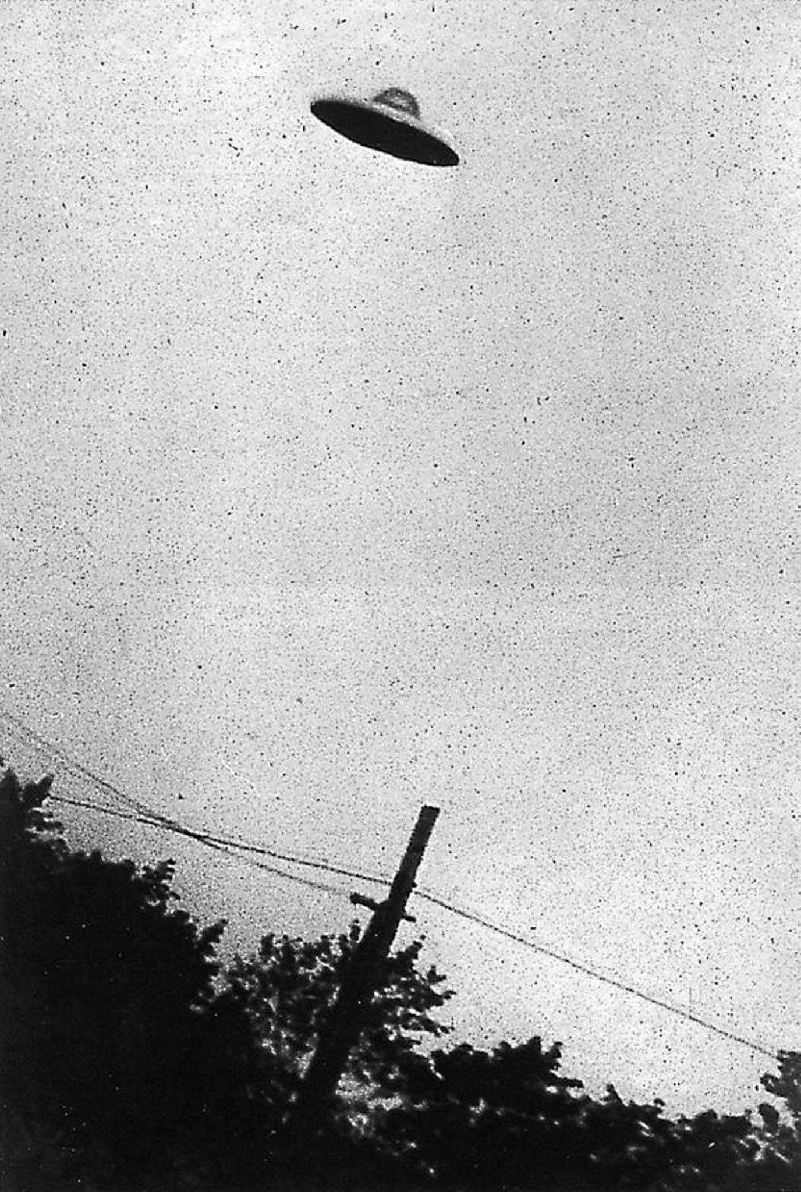
DATA COLLECTION, CLEANUP, AND EXPLORATION PROCESSES
The Proof is Out There
Began with a massive CSV file with global data from 1910 - 2014, retrieved from NURORC, which was used in week of 5 class
To reach our end goals, we needed to create a more manageable dataset and so we divided our clean-up and exploration into phases:
Phase 1: Cleaning and filtering the dataset to improve its usability and narrow the scope of our project
Phase 2: Identifying the most active period and states for UFO sightings
Phase 3: Predictions of State Data
Phase 4: Exploration and analysis of shapes of sightings
Phase 5: Predictions and Geo-Visualizations

Slide 8
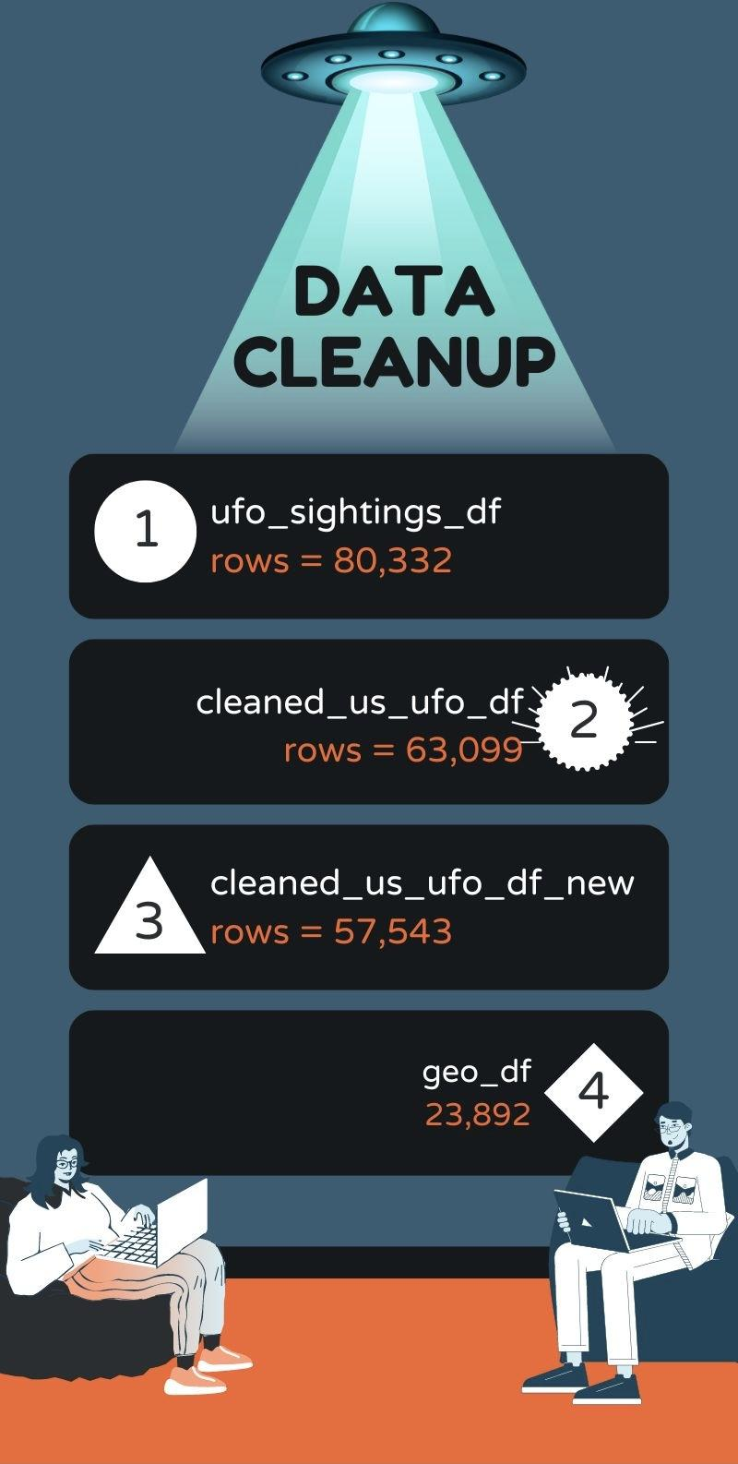
RESULTS

Slide 9
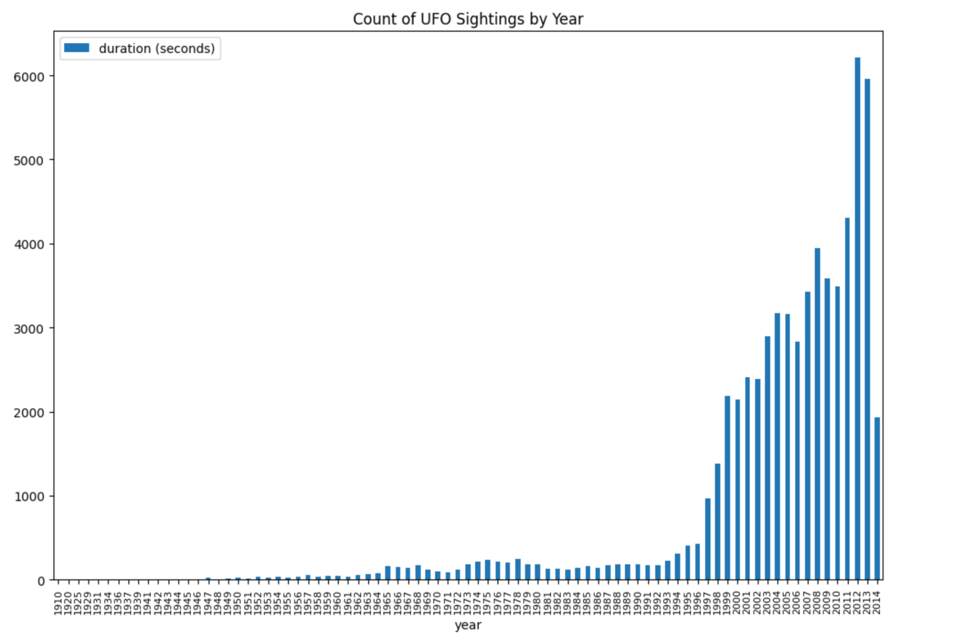
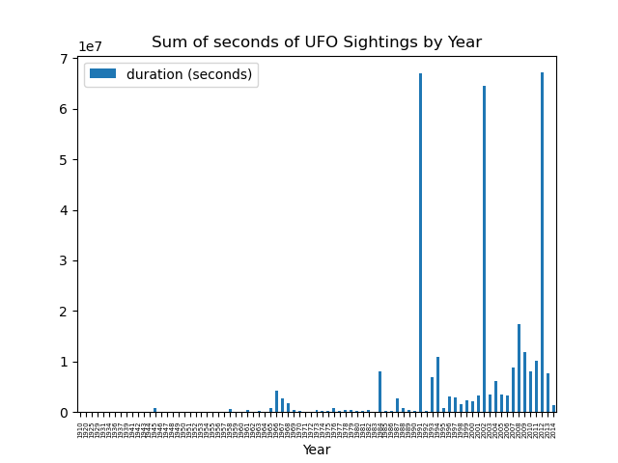
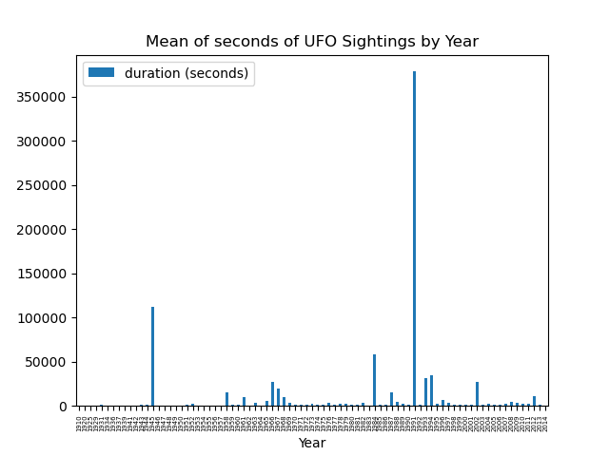
WHAT DOES DATA SHOW
Count
Sightings in seconds, by year
Mean
Sum

Slide 10

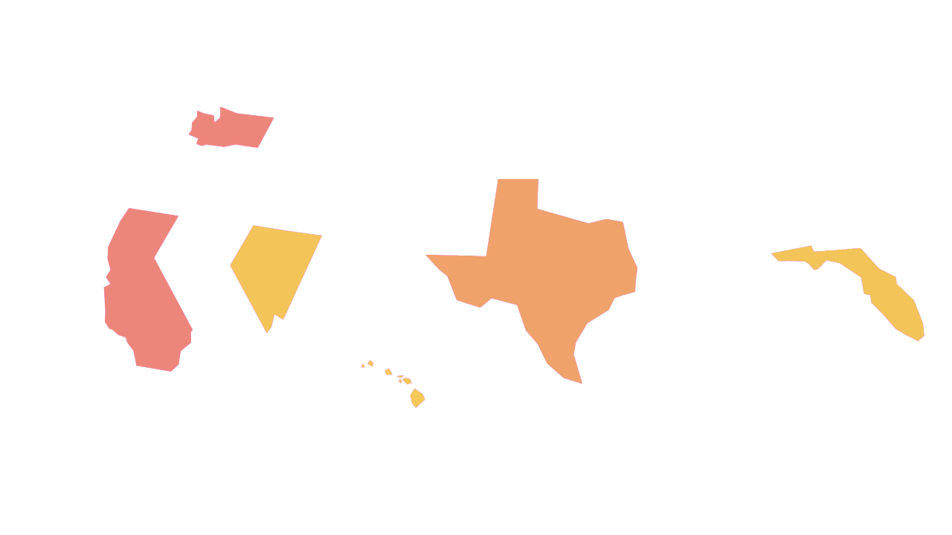
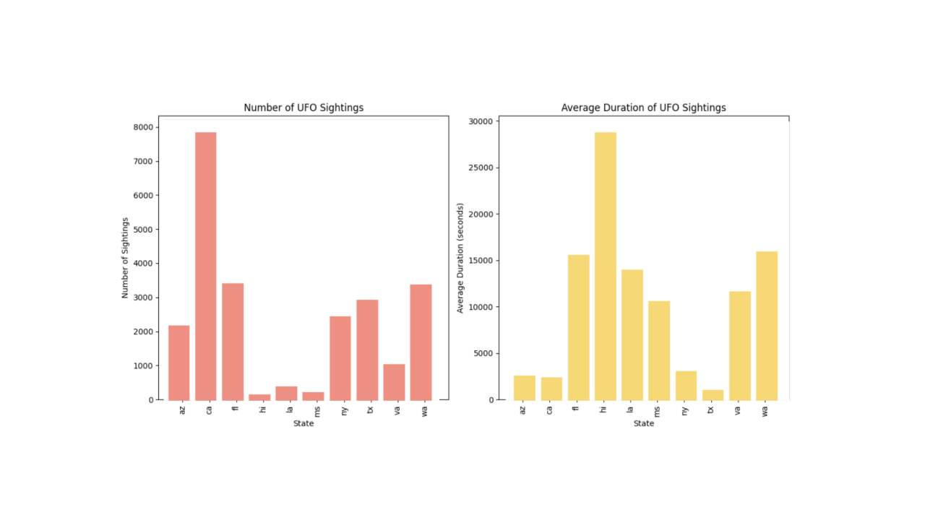
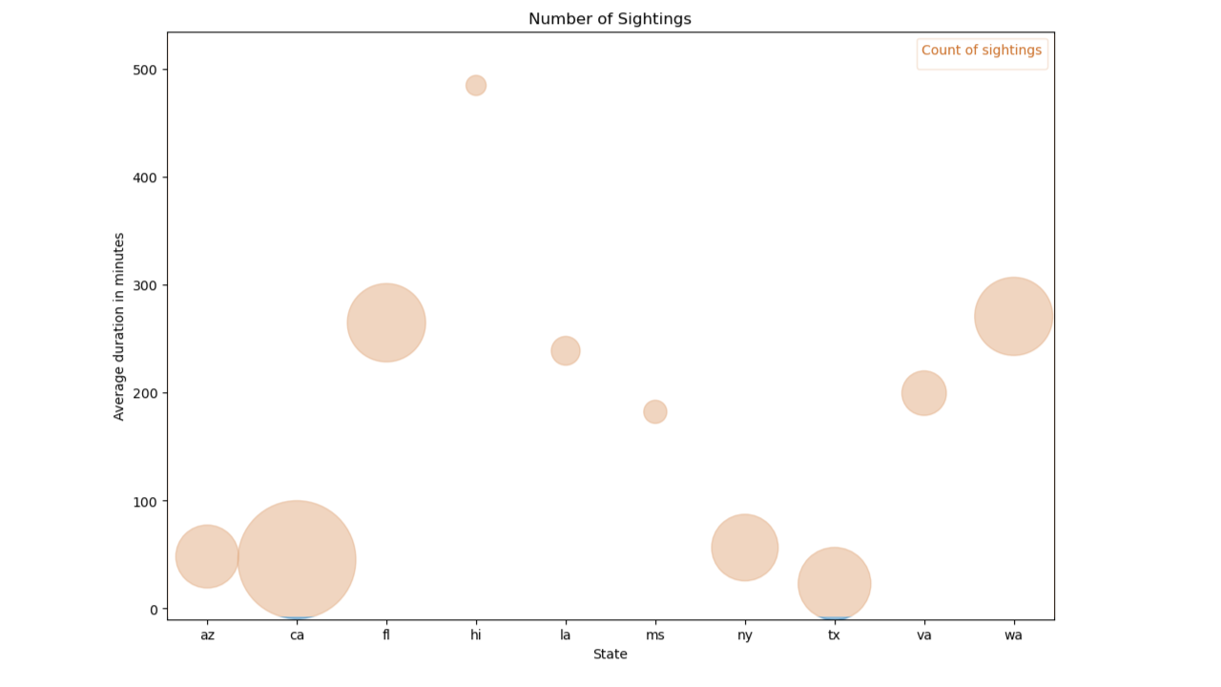
REFINING THE GEOGRAPHIC SCOPE OF DATA
Count and Duration
Top 10 states
Arizona, California, Hawaii, Louisiana, Mississippi, New York, Texas, Virginia, and Washington
Two ways to represent data

Slide 11
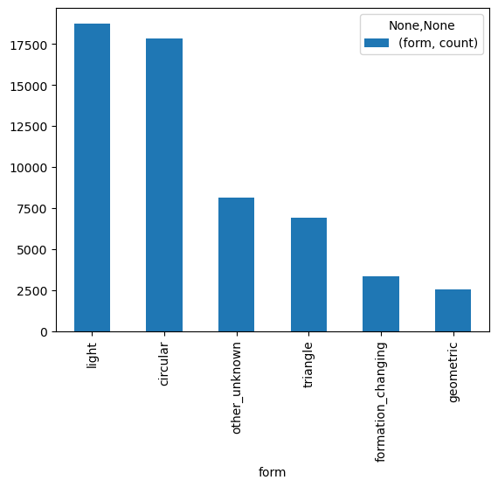
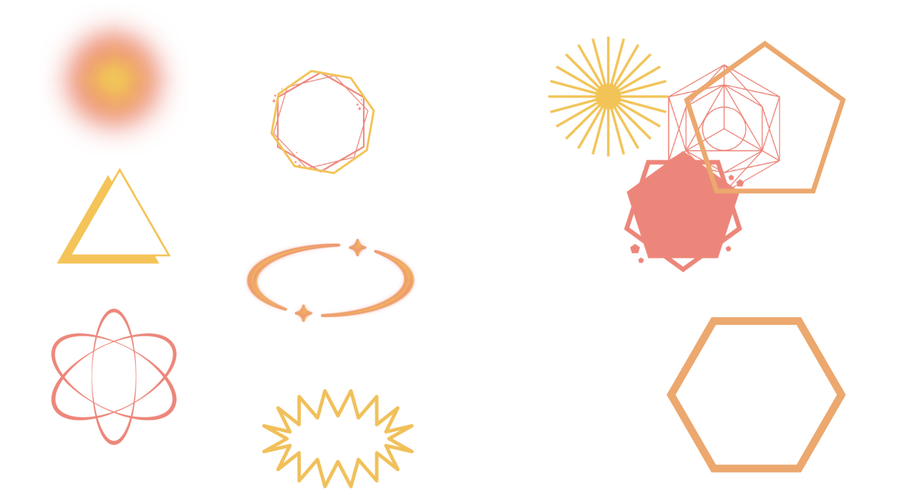
The Shapes of Things to Come
Comparing states and national trends
Unwieldy database with 28 number of options
Grouped shapes into 6 subsets
Majority: Light and Circular
Would we observe any trends in shape of the reported sightings by year, state, and sighting (count vs. long duration)
Triangle
Other /
Unknown
Formation / Changing
14%
12%
6%
Light
Circular
Geometric
32%
31%
4%

Slide 12
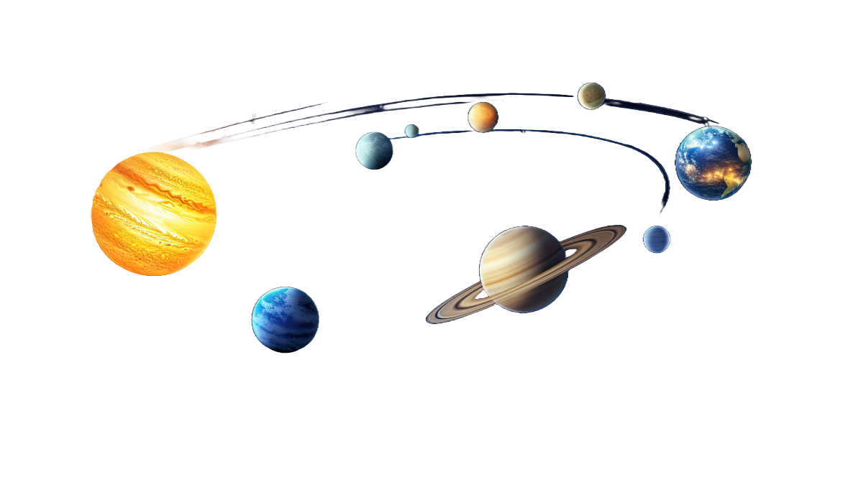
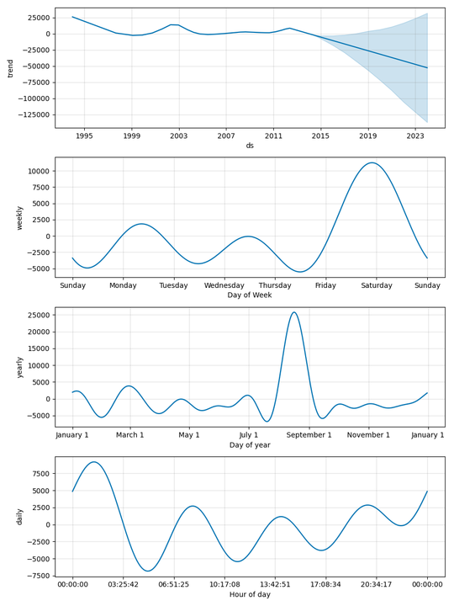
PREDICTING THE UNPREDICTABLE
Next Steps
The data seem to show a slight downward trend
Best day to view seems to be Saturday
Best time of the year - Mid to late August
Mid night through 3am is the best time
This data can be used for states to market to UFO enthusiasts. Here is a suggested tagline
Beyond the Stars: Visualizing UFO Encounters

Slide 13

REFLECTIONS AND OPPORTUNITIES
Reflections
Dataframe ends in mid-2014 and though we found a pretty reputable options to add data until 2020, we just ran out of time
Pretty large dataframe and though it was well vetted, it was difficult to work with before cleaning and took the bulk of our time
Dataset is well designed but is based on self-reporting to inherent issues
Longitude
Briefly discuss potential next steps for the project.
Confirm accuracy of the dataframe that if available to expands data to 2020
Clean and merge
Compare expected forecast with actual results and forecast out from 2020
Further explore the data and relationships
Opportunities

Slide 14
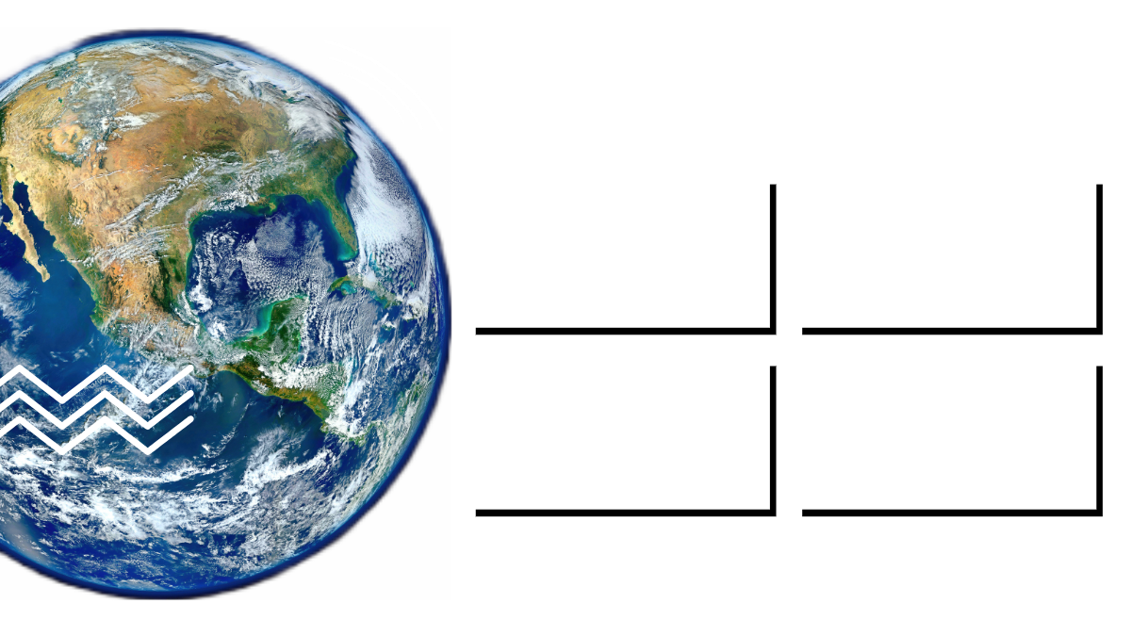
👀
Cosmic Encounters: Explore UFO Sightings Interactively
Interactive and easy find formations by state
Hover over shows data from key fields of specific encounter
Filtering the data graphically
Zoom in to a specific area for more information

Slide 15



“One man cannot summon the future.”
-Spock
Credits, references and thank yous - we couldn't have done it alone
Resources Consulted and Credit
abbreviation_to_name credit: Jeff Pain
https://gist.github.com/JeffPaine/3083347
The curriculum team and Bootcamp Spot for providing us access to the original ufoSightings.csv dataset, which we explored in Module 5
Zohaib Khawaja, for helping us find a solution to convert longitude to a numeric so that we could build our geo-visualization.

Slide 16
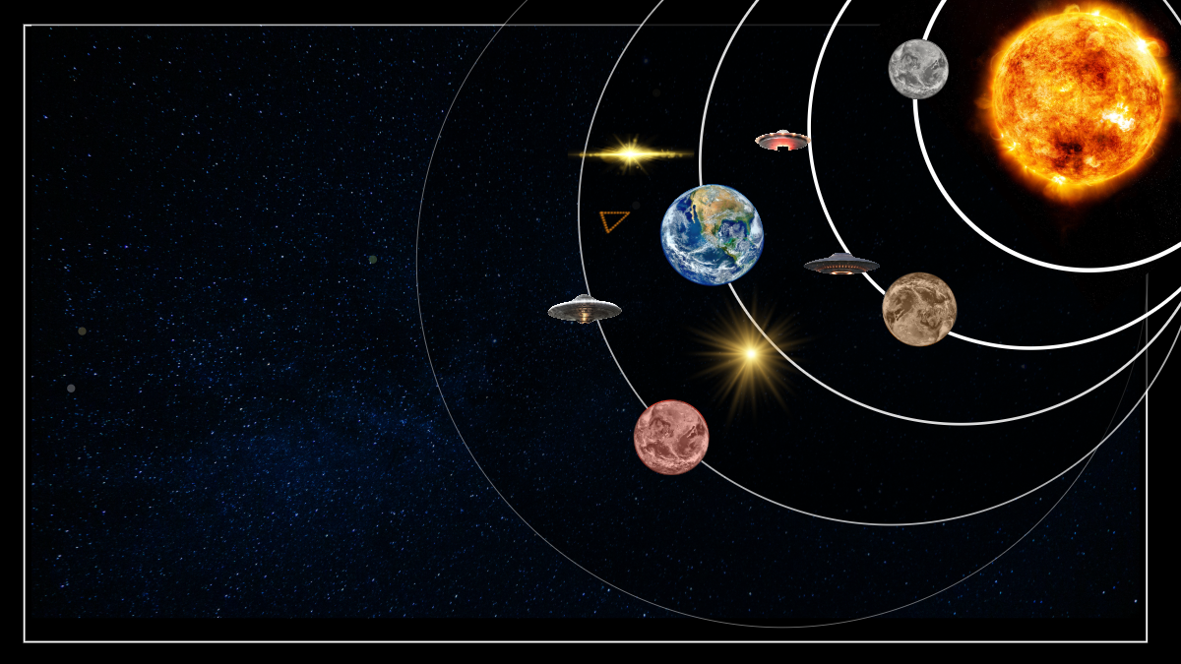

QUESTIONS?
Ask at your own risk

Slide 17


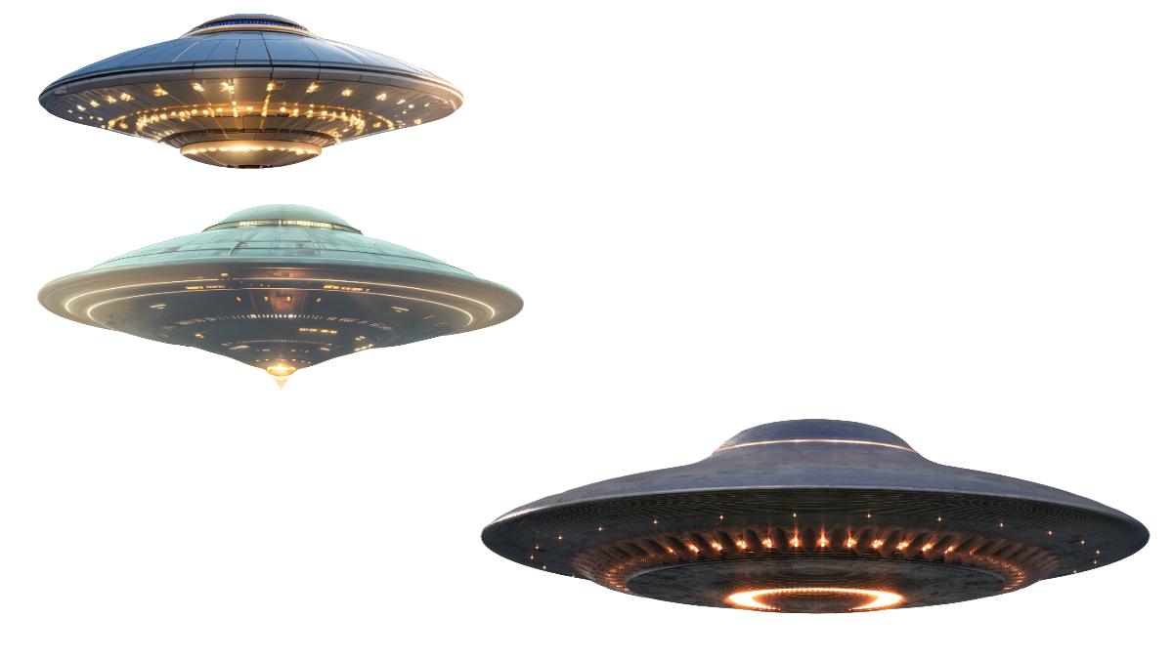
THANK YOU!
See you in the orbit

Slide 18
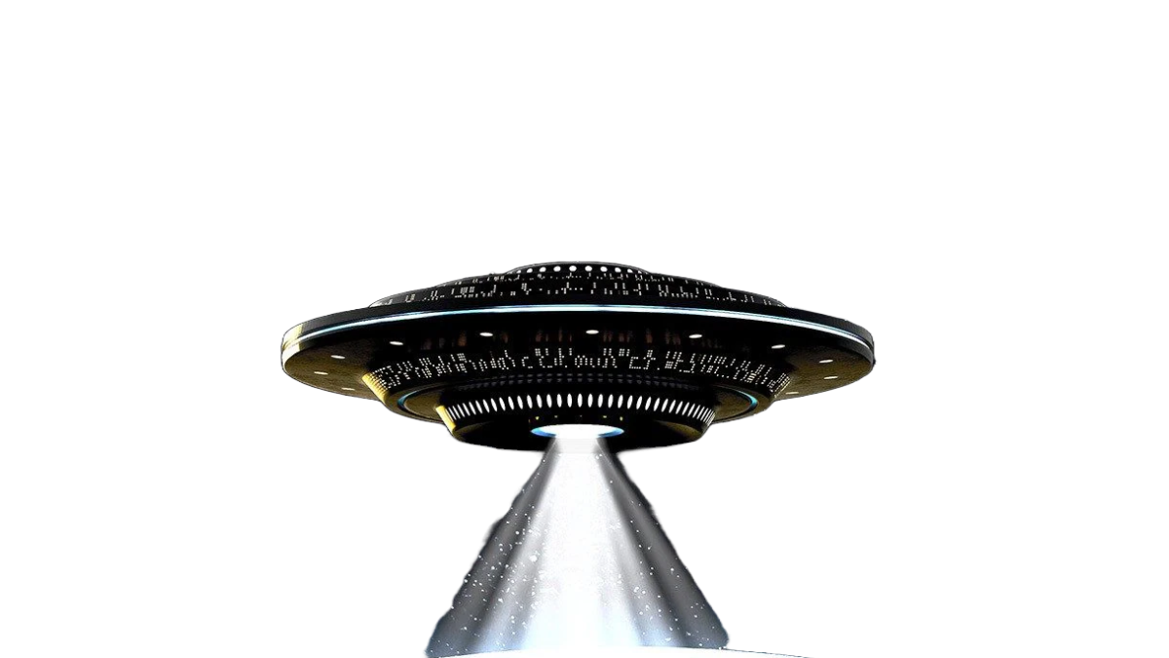
THANK YOU!

Slide 21
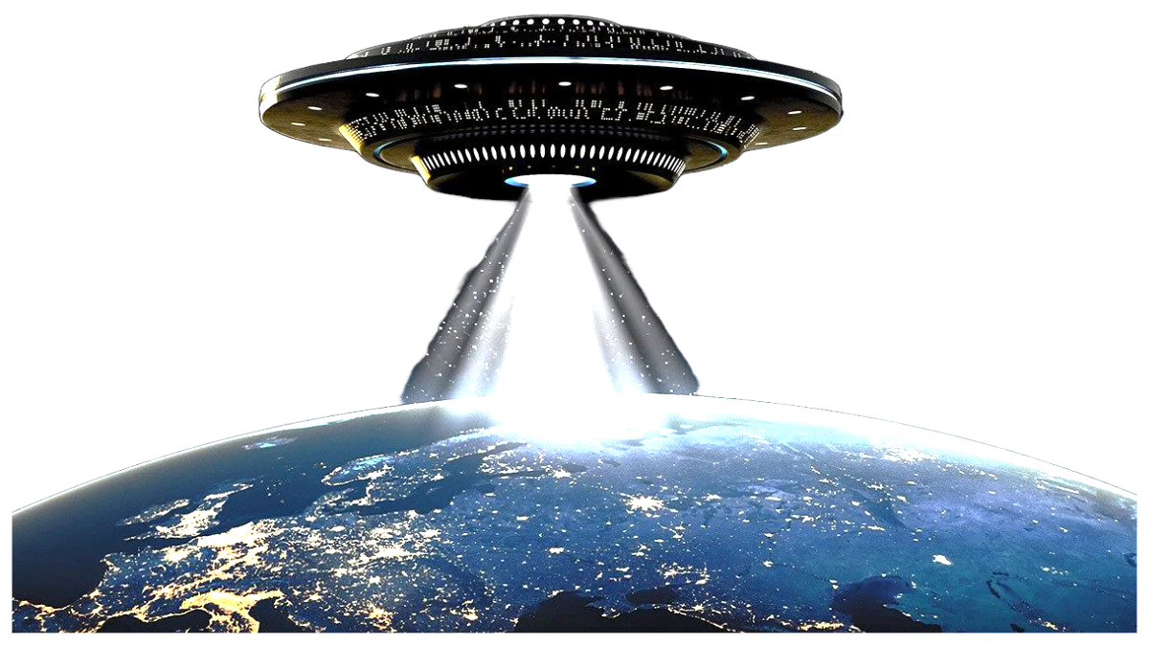

Slide 22
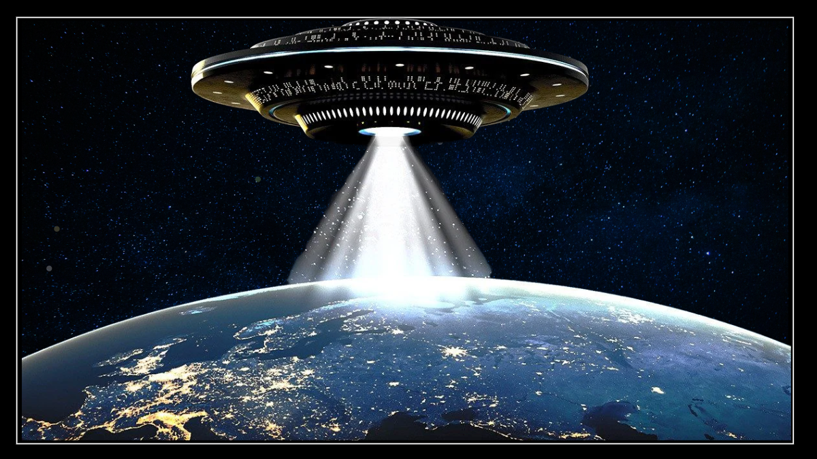
THANK YOU!

Slide 24
Results/conclusions
What trends did we observe? -Previous slide
The results/conclusions of the application or analysis:
Include relevant images or examples to support your work.- previous slide
If the project goal was not achieved, discuss the issues and how you attempted to resolve them. - reframe this as pain points - because we achieved our goals but what more could we have done? What limited our ability
Pain points
Dataframe ends in mid-2014 and though we found a pretty reputable options to add data until 2020, we just ran out of time
Pretty large dataframe and though it was well vetted, it was difficult to work with before cleaning and took the bulk of our time
Dataset is well designed but is based on self-reporting to inherent issues

Slide 25
UFO Tourist
Next steps:
Briefly discuss potential next steps for the project.
Confirm accuracy of the dataframe that is expanded to 2020
Clean that dataframe and merge
Compare expected forecast with actual results and forecast out from 2020
Further explore the data and relationships

Slide 26


Slide 28
Next steps
Next steps:
Briefly discuss potential next steps for the project.
Confirm accuracy of the dataframe that is expanded to 2020
Clean that dataframe and merge
Compare expected forecast with actual results and forecast out from 2020
Further explore the data and relationships

Slide 29
THIS IS A CHAPTER TITLE

Slide 31
Lexie
DATA COLLECTION, CLEANUP, AND EXPLORATION PROCESSES

Slide 33


Slide 34
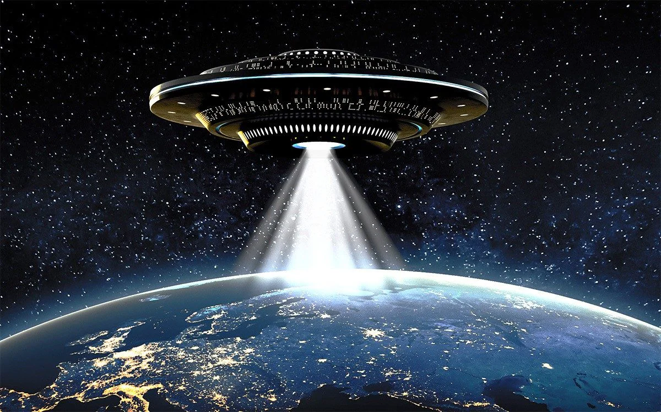

Slide 36


Slide 38
Executive Summary
How did we pick UFOs?
An executive summary or overview of the project and project goals:
Explain how the project relates to the industry you selected.
Questions?
What can we learn about previously documented and recording sightings UFO sightings?
Can we use this historical data to predict trends in future UFO sightings?
Can we use historical data to predict future UFO sightings?
Our approach

Slide 39
Overview of the data collection, cleanup, and exploration processes
Csv file had tons of data to work with
Questions
Increased extraterrestrial activity - important to know what is happening
Wherein the US are they happening
When are they happening
What do they look like
How do they act
How has actively changed over time
What can we infer from the trends and activity
An overview of the data collection, cleanup, and exploration processes:
Count vs duration
Is there a correlation or a difference between count and duration
We looked at it from different perspectives, over 300 or from 1994 on.
Count of 80%
Describe the source of your data and why you chose it for your project.
Describe the collection, exploration, and cleanup process.

Slide 40
Data Clean-Up and Manageability
Durations vs counts
Went with >300 count
Insert graph ufo sighting by year chart
Noticed uptick in data around 1990
Is there a correlation: slight negative correlation but this is an opportunity for further research and analysis because several states skewed the overall analysis
Comparing states and national trends
No correlation between count and duration so we looked at both variables
Selected the top 3 states for sightings: by count and average duration of sightings
Were there any trends?
Shapes
Unwieldy database with 28 number of options
Grouped shapes into 6 subsets
Would we observe any trends in shape of the reported sightings by year, state, and sighting (count vs. long duration)
Database An executive summary or overview of the project and project goals:
Explain how the project relates to the industry you selected.

Slide 41
Results Part 1 : Observed Trends
Count vs. Duration
States vs. National
Shapes

Slide 42
Results/conclusions
What trends did we observe? -Previous slide
The results/conclusions of the application or analysis:
Include relevant images or examples to support your work.- previous slide
If the project goal was not achieved, discuss the issues and how you attempted to resolve them. - reframe this as pain points - because we achieved our goals but what more could we have done? What limited our ability
Pain points
Dataframe ends in mid-2014 and though we found a pretty reputable options to add data until 2020, we just ran out of time
Pretty large dataframe and though it was well vetted, it was difficult to work with before cleaning and took the bulk of our time
Dataset is well designed but is based on self-reporting to inherent issues

Slide 43
UFO Touris
Next steps:
Briefly discuss potential next steps for the project.
Confirm accuracy of the dataframe that is expanded to 2020
Clean that dataframe and merge
Compare expected forecast with actual results and forecast out from 2020
Further explore the data and relationships

Slide 44
Next steps
Next steps:
Briefly discuss potential next steps for the project.
Confirm accuracy of the dataframe that is expanded to 2020
Clean that dataframe and merge
Compare expected forecast with actual results and forecast out from 2020
Further explore the data and relationships

Slide 45
UFO photo links
https://time.com/4232540/history-ufo-sightings/
https://www.history.com/news/ufo-sightings-credible-modern
https://timesofindia.indiatimes.com/etimes/trending/5-times-ufo-like-objects-were-spotted-on-earth/photostory/107431493.cms?picid=107431504
https://www.axios.com/2024/02/08/ufo-uap-sightings-us-hotspots-2000-2023

Slide 47


UFO photo links
https://time.com/4232540/history-ufo-sightings/

Slide 48
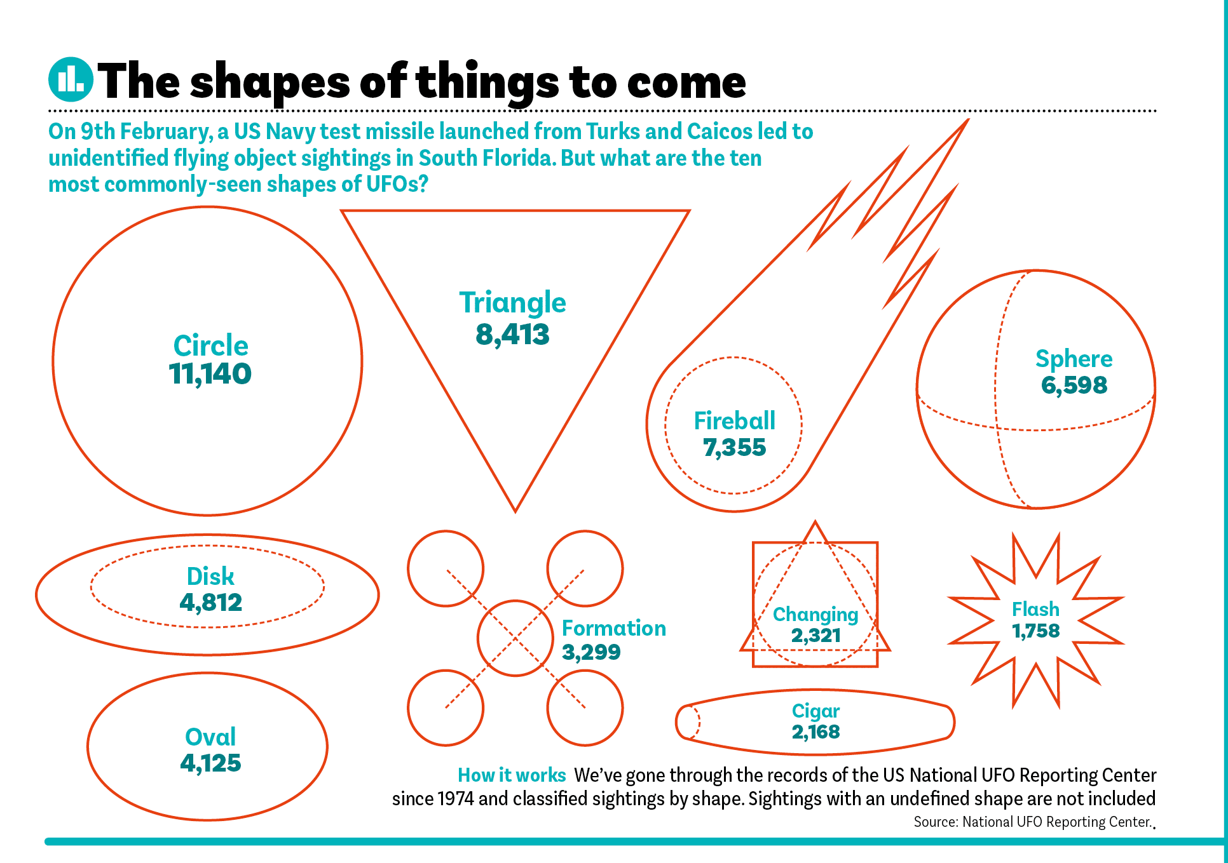

Slide 49
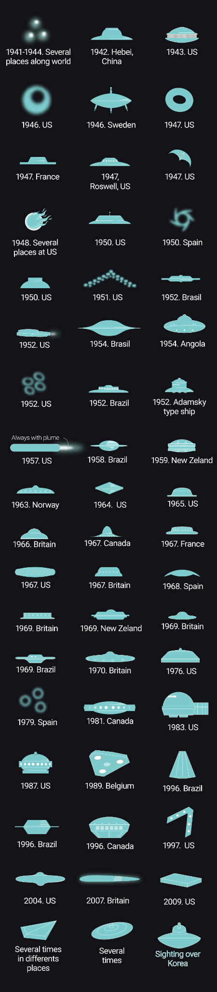
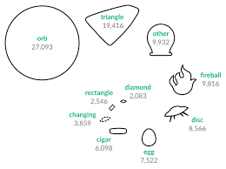
UFO photo links

Slide 50
Presentation Requirements (30 points)
Your presentation should cover the following:
An executive summary or overview of the project and project goals (5 points).
An overview of the data collection, cleanup, and exploration processes (5 points).
The approach that your group took in achieving the project goals (5 points).
Any additional questions that surfaced, what your group might research next if more time was available, or share a plan for future development (5 points).
The results and conclusions of the application or analysis (5 points).
Slides effectively demonstrate the project (3 points).
Slides are visually clean and professional (2 points).

Slide 51
Presentation Guidelines
This section lists the Project 1 presentation guidelines. Each group will prepare a formal, 10-minute presentation that covers the following points.
An executive summary or overview of the project and project goals:
Explain how the project relates to the industry you selected.
An overview of the data collection, cleanup, and exploration processes:
Describe the source of your data and why you chose it for your project.
Describe the collection, exploration, and cleanup process.
The approach that your group took to achieve the project goals:
Include any relevant code or demonstrations of the application or analysis.
Discuss any unanticipated insights or problems that arose and how you resolved them.
The results/conclusions of the application or analysis:
Include relevant images or examples to support your work.
If the project goal was not achieved, discuss the issues and how you attempted to resolve them.
Next steps:
Briefly discuss potential next steps for the project.

Slide 52


Slide 53
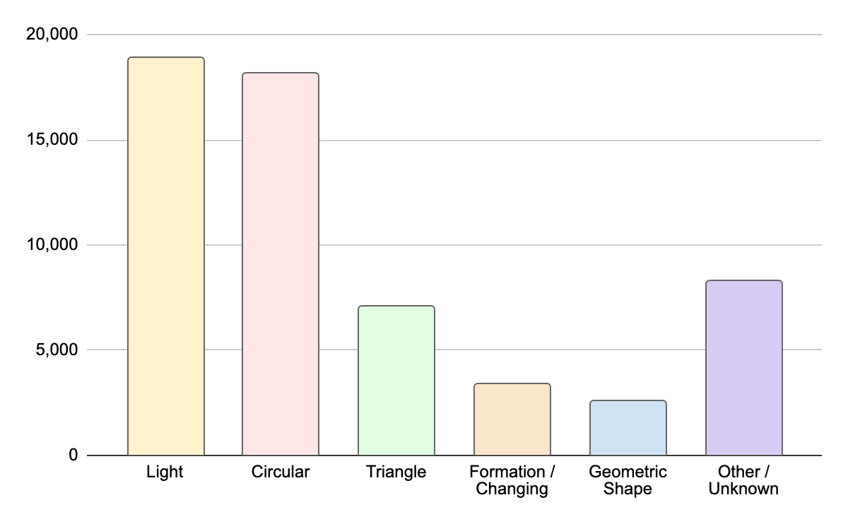
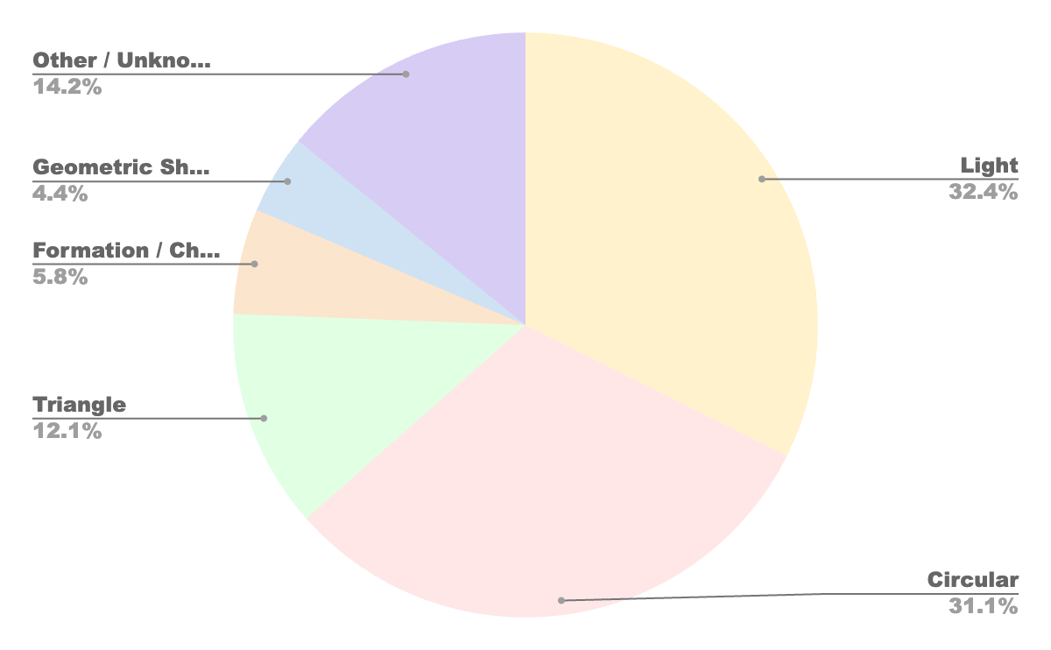
Light |  | Circular |  | Triangle |  | Formation / Changing |  | Geometric Shape |  | Other / Unknown
fireball | 4989 | cigar | 1359 | chevron | 745 | formation | 1896 | diamond | 862 | other | 4052
flare | 1 | circle | 5644 | delta | 5 | changed | 1 | hexagon | 1 | unknown | 4206
flash | 1040 | round | 2 | triangle | 6082 | changing | 1505 | crescent | 1
light | 12860 | sphere | 3976 | pyramid | 1 |  |  | cross | 178
 |  | oval | 2671 | cone | 234 |  |  | rectangle | 953
 |  | egg | 533 |  |  |  |  | teardrop | 570
 |  | cylinder | 926
 |  | disk | 3013
 | 18,890 |  | 18,124 |  | 7,067 |  | 3,402 |  | 2,565 |  | 8,258

Slide 56
THIS IS A TITLE
This is a subtitle
The quick brown fox jumped over the lazy dog into a shimmering pool of rainwater that had gathered since the last frost. Soft clusters of leaves fall without a plan to the ground, mirroring the unhurried chestnut thatch of the fox’s dense coat. ​ The fox looks to the west, only then realizing the horizon has begun to curve towards them. Perhaps they should not have jumped so soon.​
The quick brown fox jumped over the lazy dog into a shimmering pool of rainwater that had gathered since the last frost. ​
Soft clusters of leaves fall without a plan to the ground, mirroring the unhurried chestnut thatch of the fox’s dense coat.

Slide 57
DATA COLLECTION
The Proof is Out There
The quick brown fox jumped over the lazy dog into a shimmering pool of rainwater that had gathered since the last frost. Soft clusters of leaves fall without a plan to the ground, mirroring the unhurried chestnut thatch of the fox’s dense coat. ​ The fox looks to the west, only then realizing the horizon has begun to curve towards them. Perhaps they should not have jumped so soon.​
The quick brown fox jumped over the lazy dog into a shimmering pool of rainwater that had gathered since the last frost. ​
Soft clusters of leaves fall without a plan to the ground, mirroring the unhurried chestnut thatch of the fox’s dense coat.

Slide 58
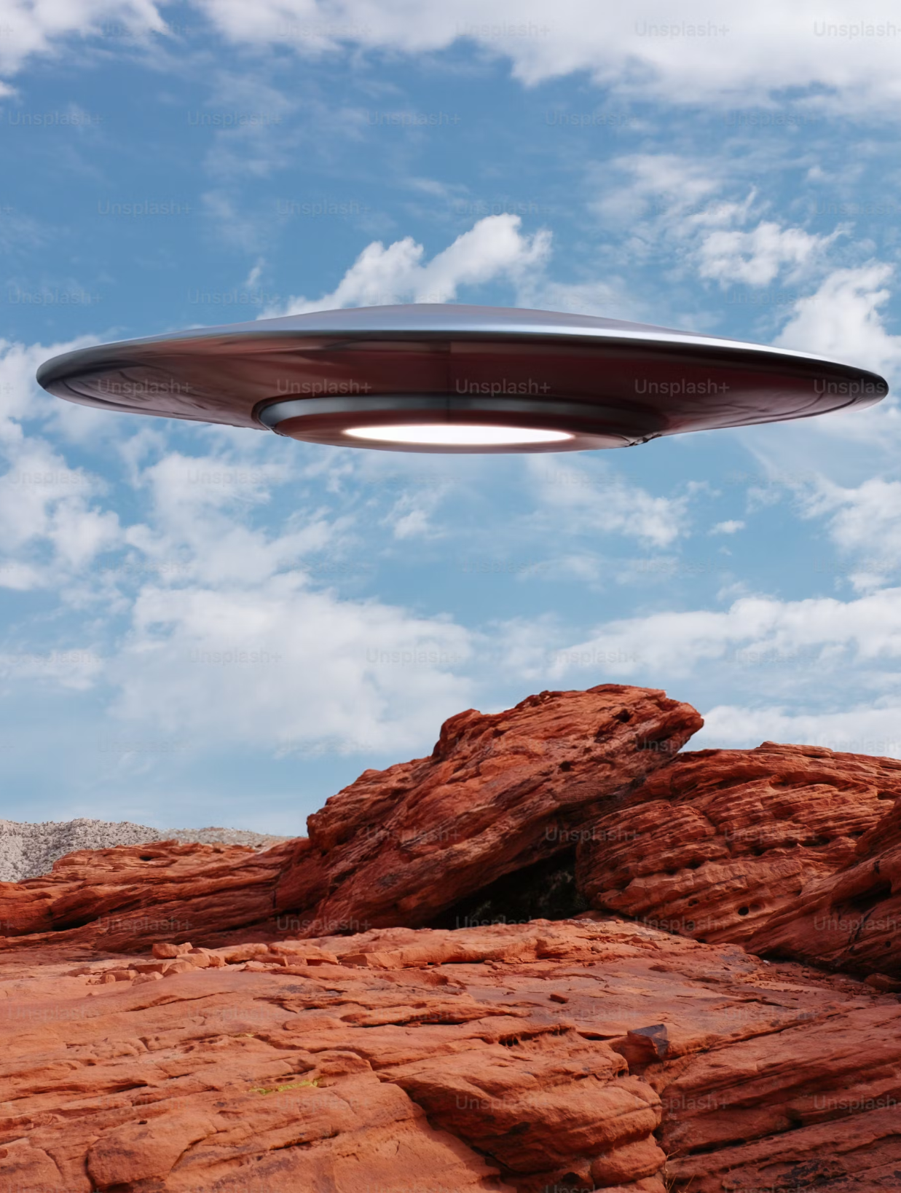



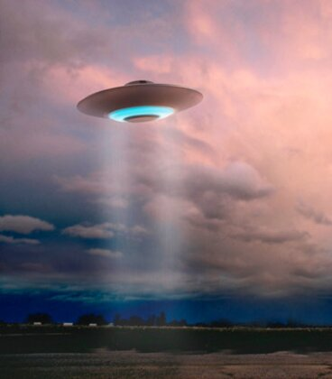

Slide 60
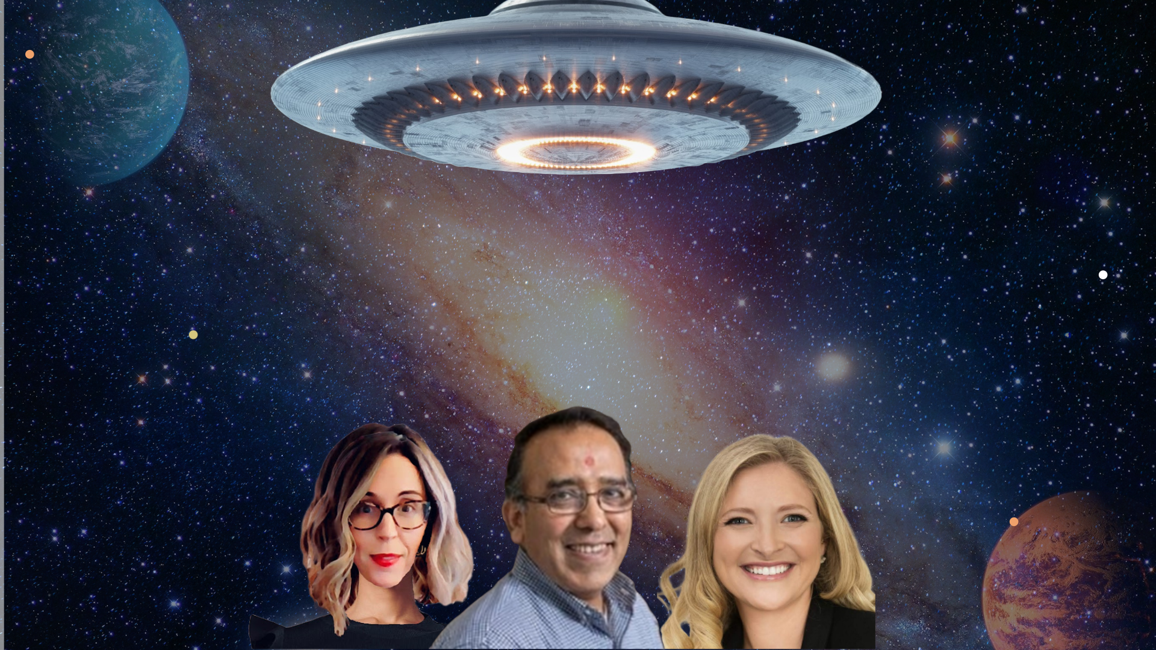
THE TRUTH IS OUT THERE
TEAM PICARD

Slide 61
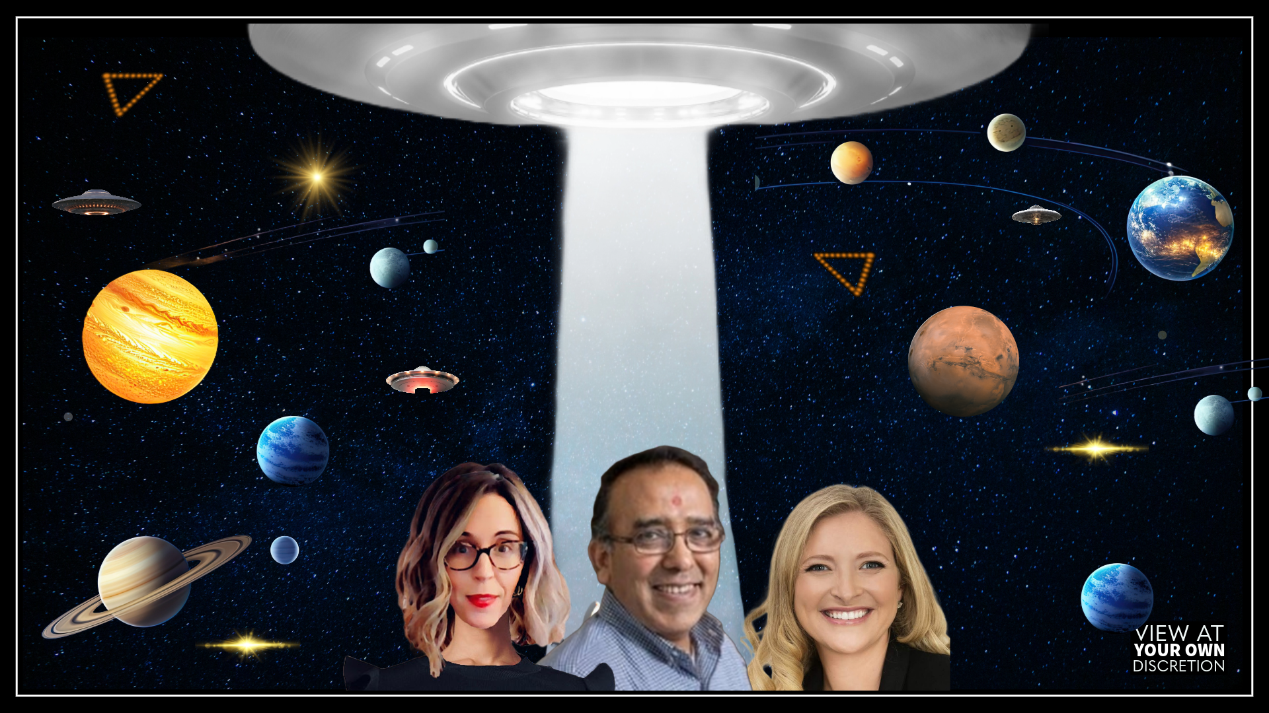
THE TRUTH IS OUT THERE

Slide 62


